Slide 1
RackM8
Functional Prototype
Mehul Pandey, Jeffrey Hanke, Sam Huang, Sean Su

Slide 2
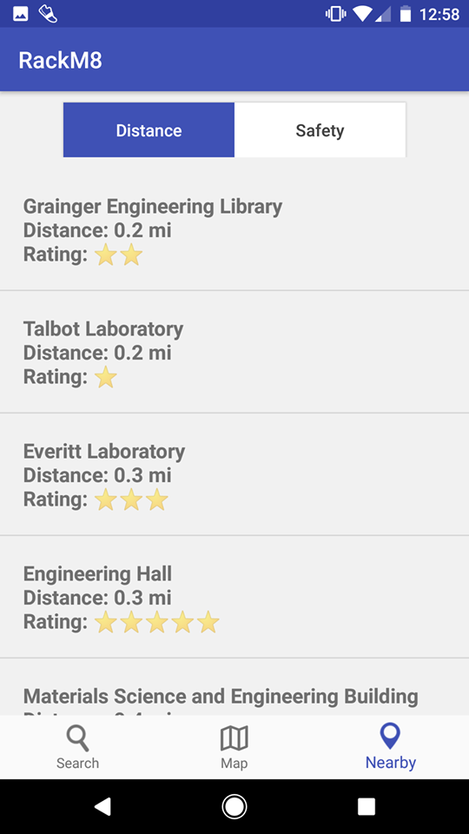
Task 1: Organize Locations by Distance/Safety
Problem:
Finding bike parking that is nearby and/or safe
Prototype:
Two pages:
Nearby page arranges buildings by their distances away from the user’s current location (low to high)
Safety page arranges buildings based on their safety ratings in 5-star ratings (high to low)
Clicking on a building directs the user to the Map page
Process:
Determined bike rack characteristics that are important to users through user interviews
Distance and safety

Slide 3
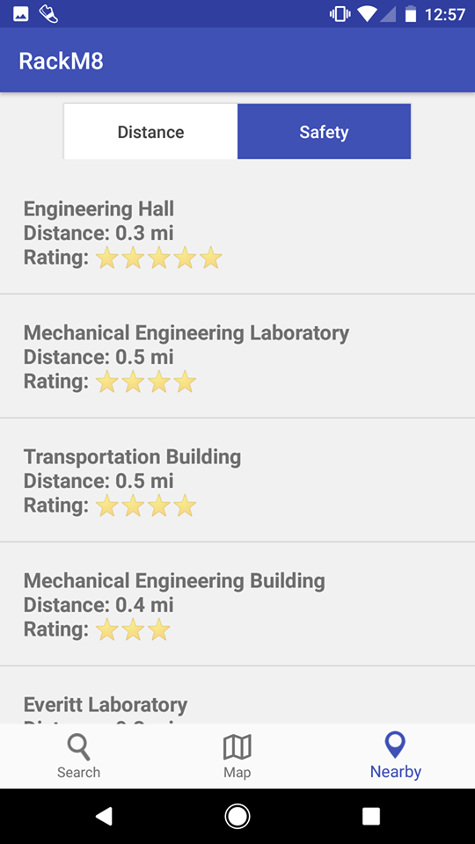
Task 1: Organize Locations by Distance/Safety
Prototype Changes:
Displayed both the Rating and Distance for each building
Changed the number rating to become stars
Clicking on the buttons will sort the buildings by either Distance or Rating
Process:
Found that having a visual rating system such as stars will help users visualize the rating rather than seeing just text
Easier for users to see both info in order to figure out which building to park near

Slide 4
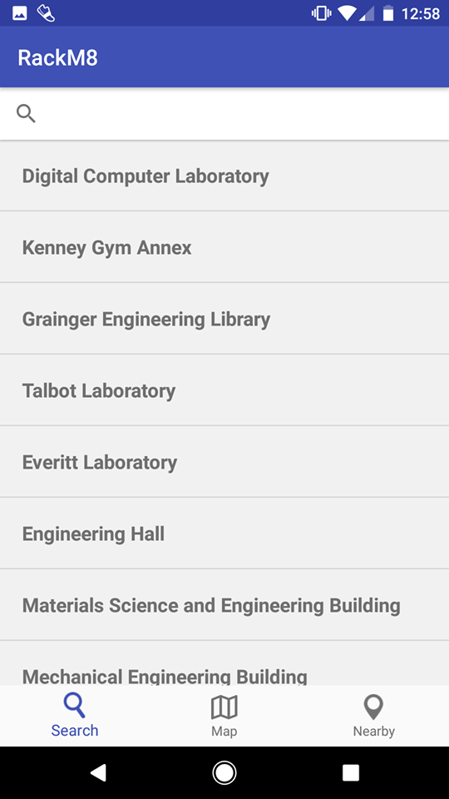
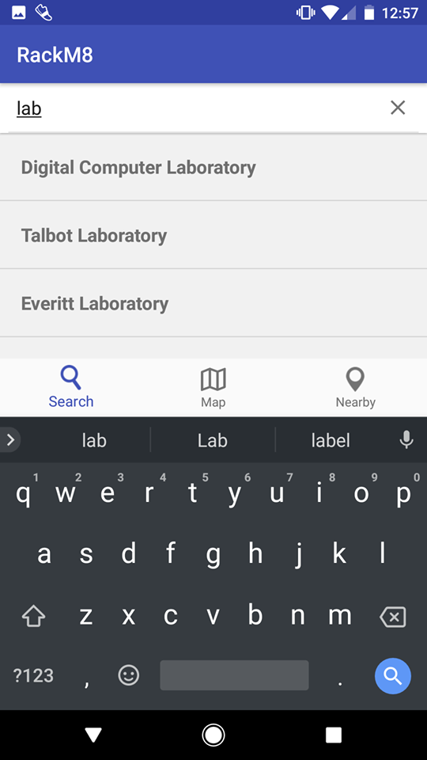
Task 2: Parking Search by Building
Problem:
Finding bike parking at a known building location
Prototype:
Displays a list of buildings on campus
Search bar on top to look up specific locations
Filters buildings list as you type
Clicking on building brings up the building on map view and displays surrounding bike racks
Process:
Although users may know their destination, they may not necessarily know exactly where to leave their bikes in that area
Therefore we used a familiar list of buildings and a simple search interface to allow users to pick their desire building
Then we presented a visual map of bike racks near the selected building

Slide 5
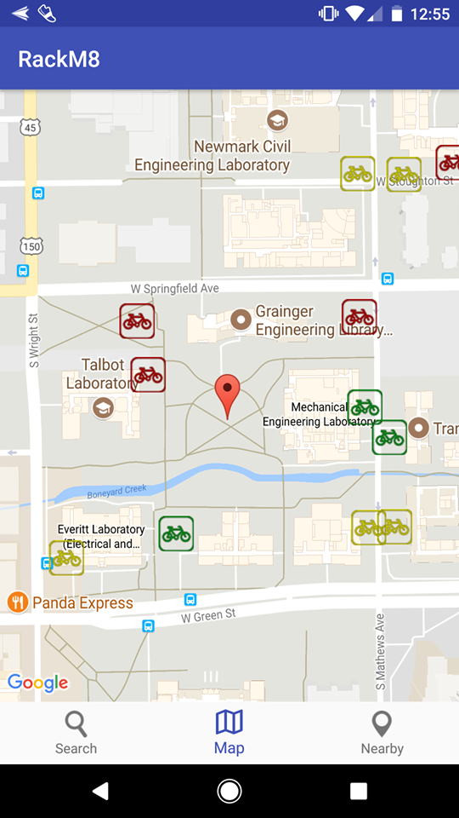
Task 3: Map Overview of Bike Racks
Problem:
Difficulty locating a bike rack without a map
Prototype:
Uses Google Maps API to display bike racks for each building
Simple layout and easy to navigate
Starts at your current location
Drag to navigate a designated area
Bike racks are color-coded green, yellow, and red corresponding to their safety ratings, which comes from user input
Maps is the main landing page so that users can find the buildings easier
Process:
Inspired by existing parking apps that include a map view for visualizing an area

Slide 6
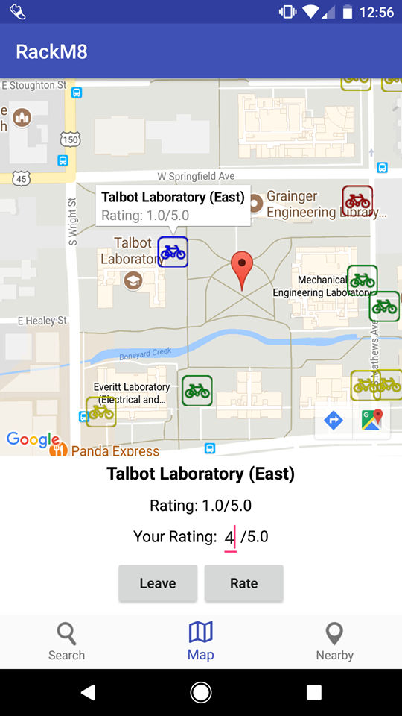
Task 3: Map Overview of Bike Racks
Prototype Changes:
Color-code the bike racks based on safety
Bike rack buttons display an information page with more functionalities
Pressing “Park” marks the bike rack on the map blue to easily track it.
Only allows for rating for your parking spot once you park your bike and restricting to one rate per park
Pressing “Leave” when done parking to unmark it.
Input a safety rating out of 5 and press “Rate” to submit.
Process:
Better user experience to visually see ratings with color codes than having to manually click each rack
One important functionality we needed to add was the ability to “park here”
Realized we could gather safety ratings from user input

